Slide 1

Getting Started with Dependency Injection in .NET
workshop, August 30, 2019
make our code easier to maintain, extend, and test
Steven-feixia.hu, R&D Engineer

Slide 2

Defining Dependency Injection

Slide 3
Dependency Injection (DI)
A set of software design principles and patterns that enable us to develop loosely coupled code.
Mark Seemann, Dependency Injection in .NET, 2018

Slide 4
Dependency Injection (DI)
A set of software design principles and patterns that enable us to develop loosely coupled code.
Mark Seemann, Dependency Injection in .NET, 2018

Slide 5
Benefits of Loosely Coupled Code
Code that is loosely coupled is easier to extend. We can add functionality without making changes to all of our objects.
Loosely-coupled code is easier to test. We can isolate pieces of functionality so that we can write short, easy-to-read unit tests.
We also get code that is easier to maintain. When something goes wrong, we can more easily find the piece of our code that needs to be updated.
Merge conflicts become quite rare. If we have loosely-coupled code, then the developers working on the business logic are changing their files, and the developers working on the data access are changing their files.
Loose coupling makes late binding much easier. Late binding, or runtime binding, is when we make decisions at runtime rather than compile time, and this can be very useful for certain scenarios.

Slide 6

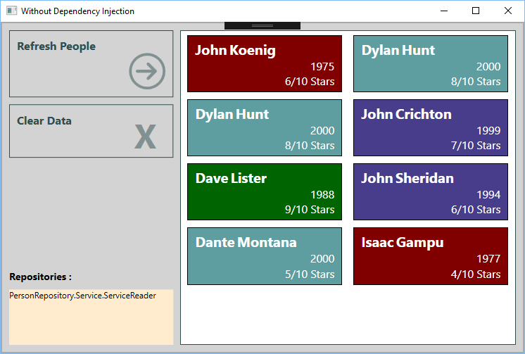
Simple: One Screen Application

Slide 7

Complex: Multiple Layers

Slide 8
Code Review
Let’s go to Visual Studio

Slide 9
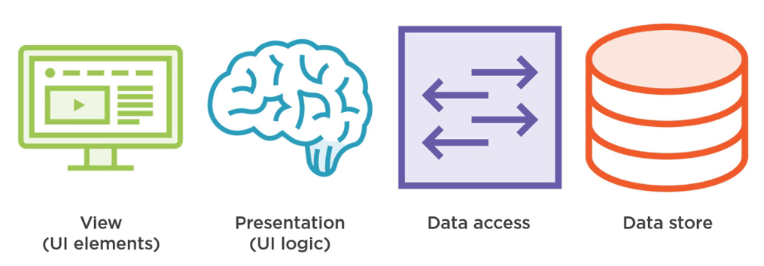
Application Layers

Slide 10
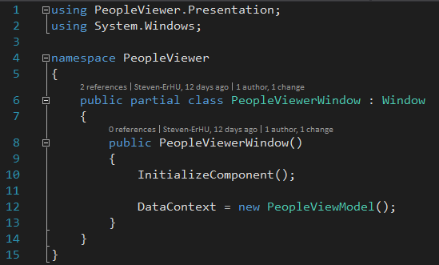
View => Presentation

Slide 11
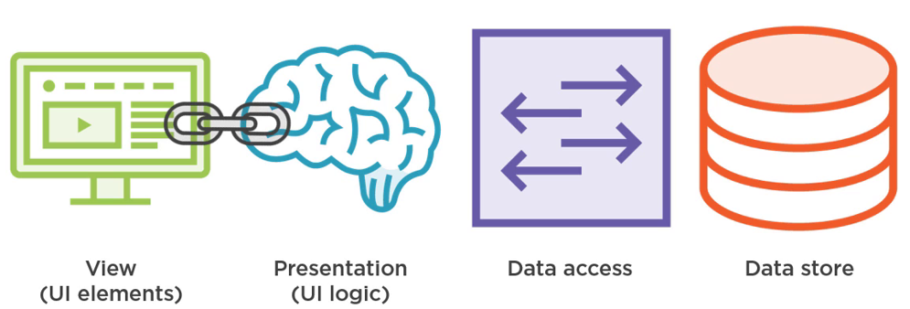
Tight Coupling

Slide 12
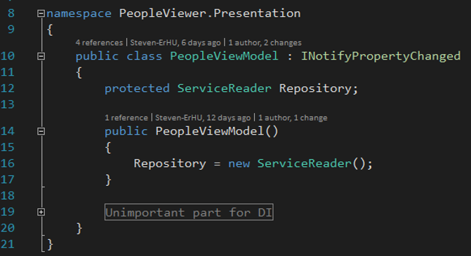
Presentation => Data Access

Slide 13
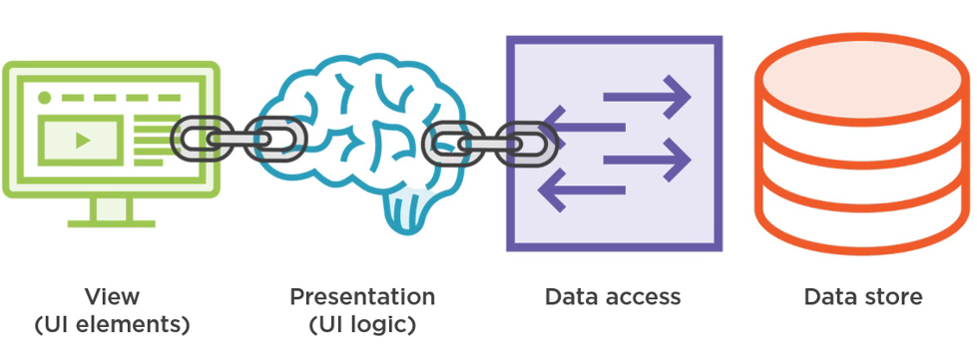
Tight Coupling

Slide 14
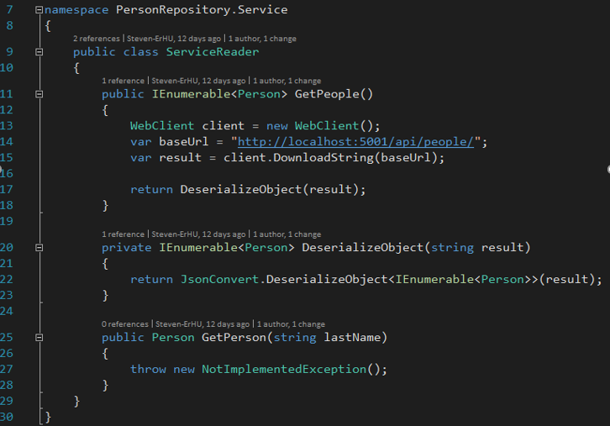
Data Access => Data Store

Slide 15
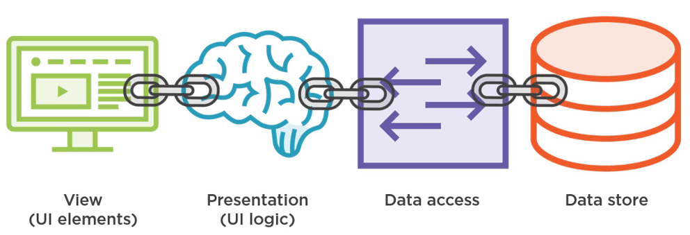
Tight Coupling

Slide 16
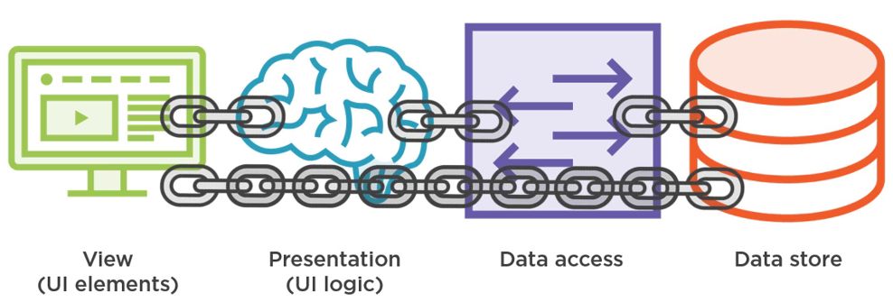
Tight Coupling

Slide 17
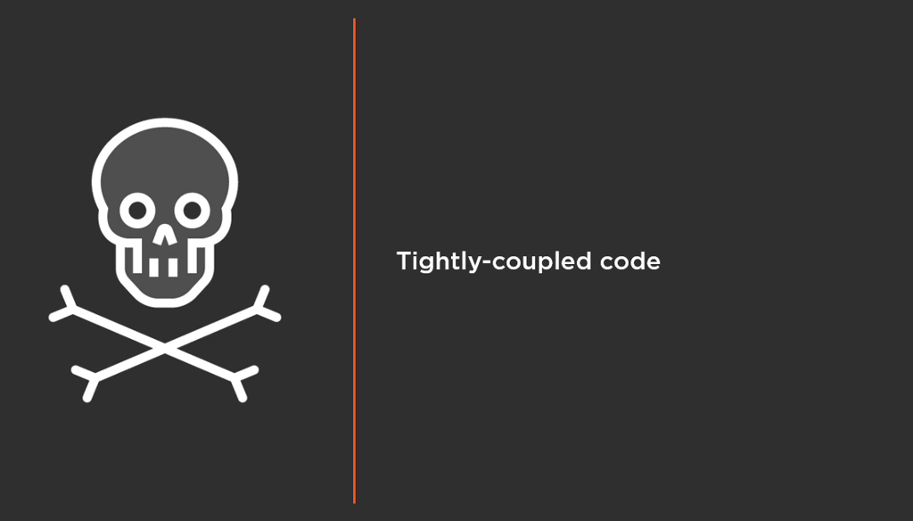

Slide 18
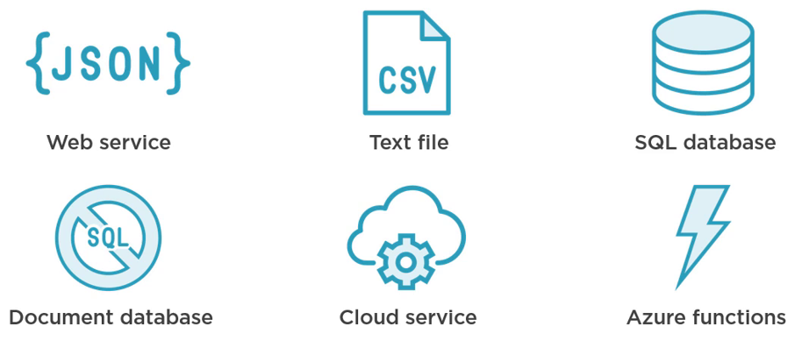
Request 1: Different Data Source

Slide 19
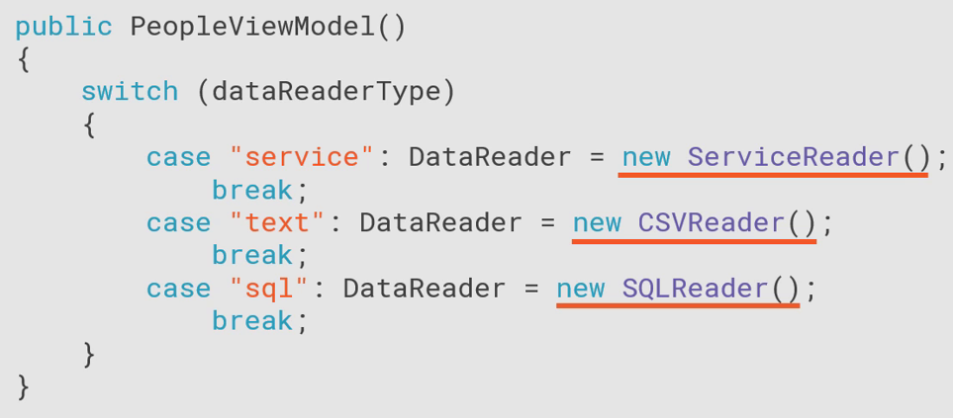
Request 1: Different Data Source

Slide 20
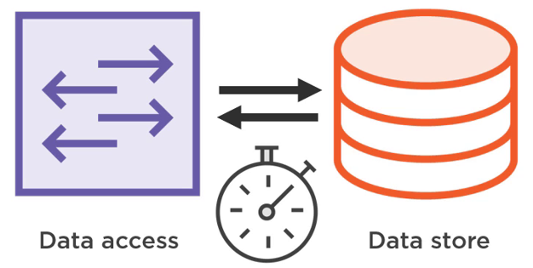
Request 2: Client-side Cache

Slide 21
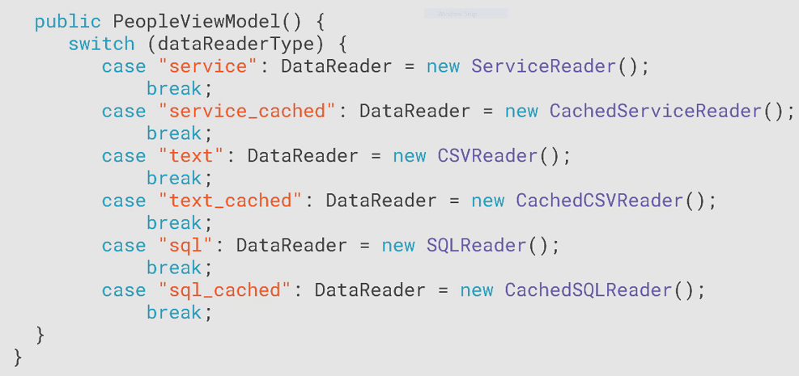
Request 2: Client-side Cache

Slide 22
SOLID – Single Responsibility Principle
Violation
Current view model responsibilities
Presentation logic
Picking the data source
Managing object lifetime
Deciding to use a cache

Slide 23
SOLID – Single Responsibility Principle
A class should have only one reason to change

Slide 24
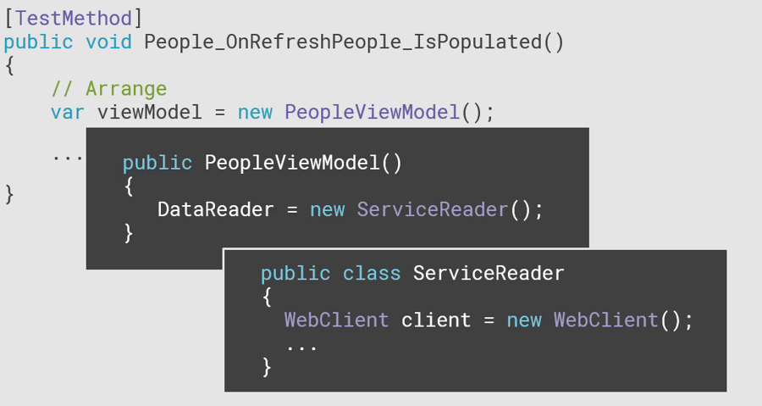
Request 3: Unit Test

Slide 25
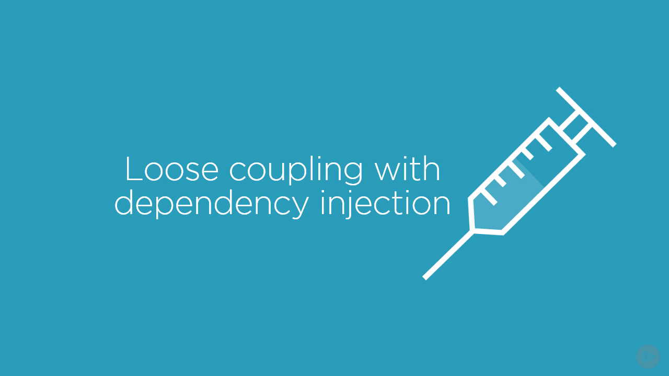

Slide 26
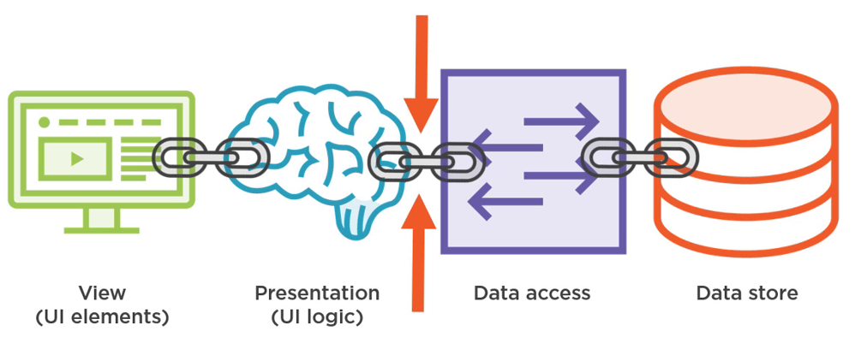
Break Tight Coupling

Slide 27
Break Tight Coupling
Three steps
Add a bit of abstraction to loosen up the code.
use constructor injection, one of the dependency injection patterns, to create loosely-coupled code.
Put them together, which is known as object composition.

Slide 28
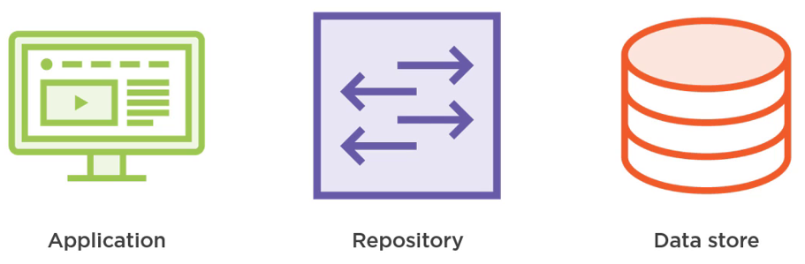
Repository Pattern
Separates our application from the data storage technology

Slide 29
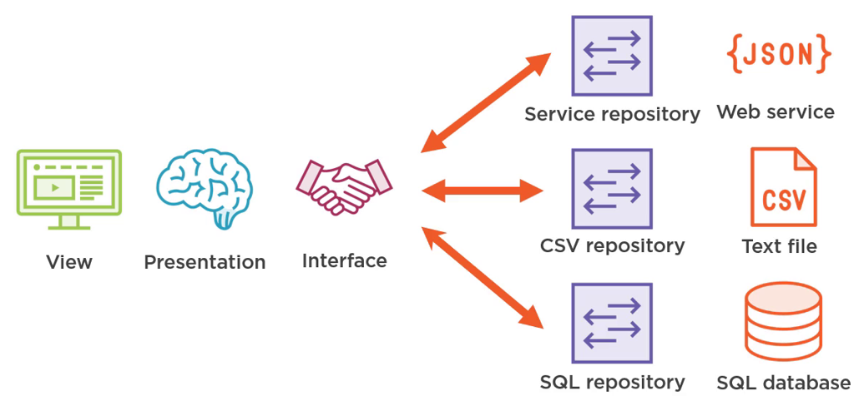
Step1: Adding an Interface

Slide 30
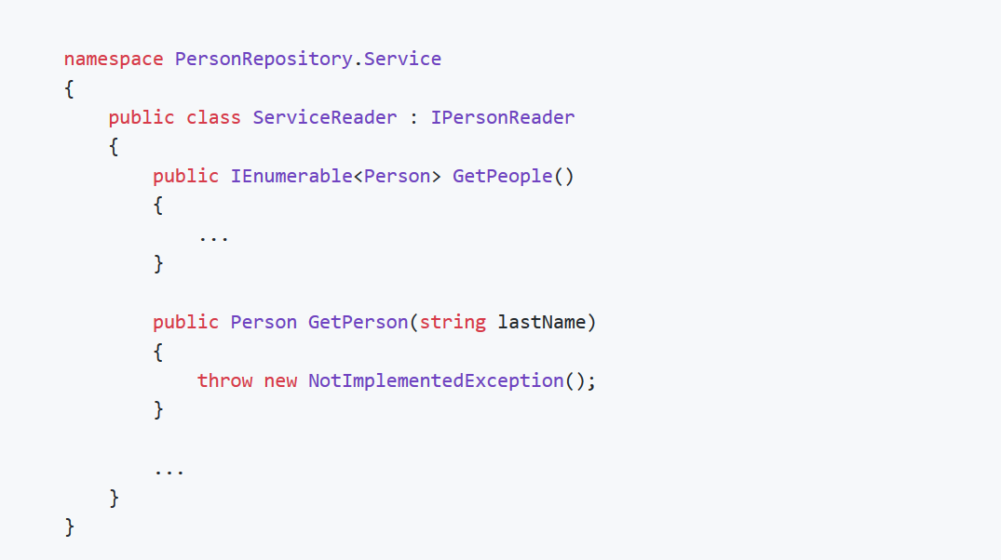
Inheritance

Slide 31
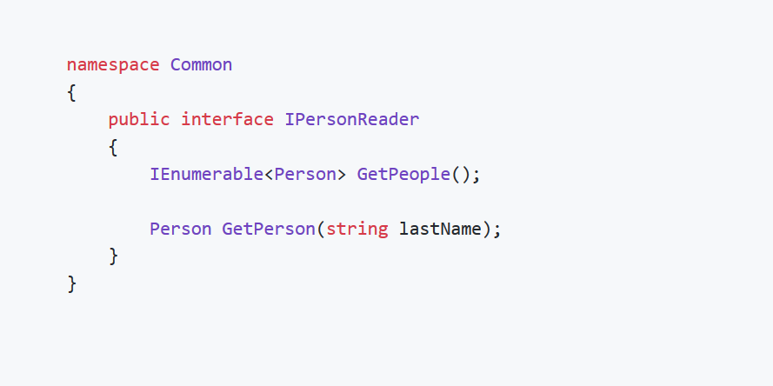
The Interface

Slide 32
SOLID – Interface Segregation
CRUD Repository - Create, Read, Update, Delete
Clients should not be forced to depend upon interfaces that they don't use.

Slide 33
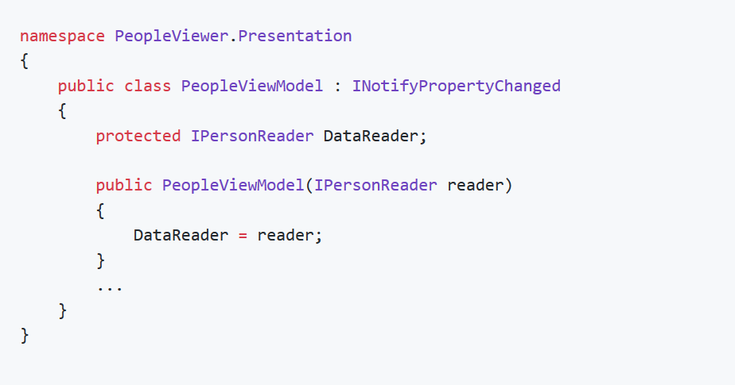
The View Model
Step2: Using Constructor Injection
Dependency
Inject the dependency using the constructor

Slide 34
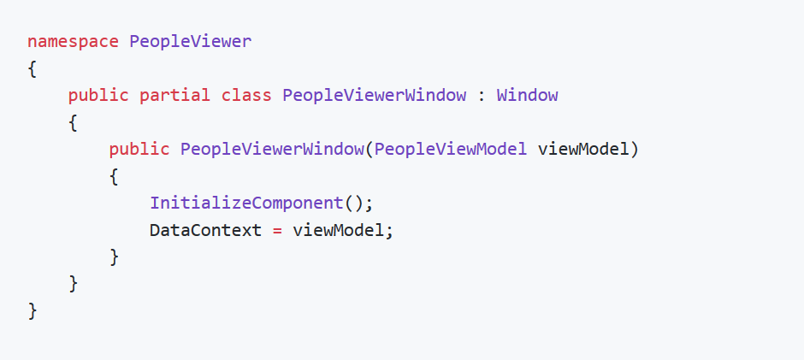
The View
Step2: Using Constructor Injection
Inject the dependency using the constructor
Dependency

Slide 35
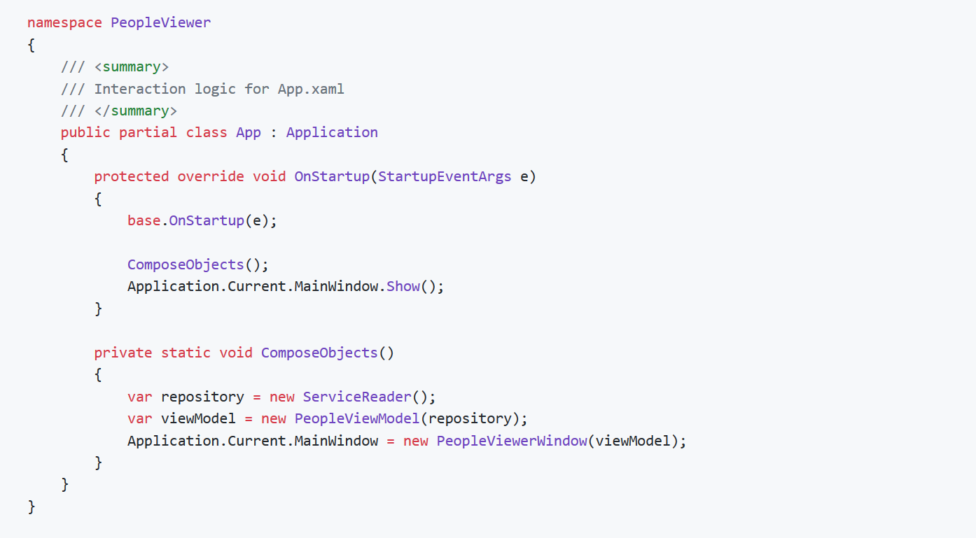
Step3: Object Composition

Slide 36

Step3: Object Composition
Bootstrapper: The OnStartup method in App class

Slide 37
SOLID – Liscov Substitution Principle
App can use cache reader just like any other data readers
Substitutable by CSVReader, ServiceReader…

Slide 38
SOLID – Liscov Substitution Principle
Subtypes must be substitutable for their base types.

Slide 39
SOLID – Dependency Inversion Principle

Slide 40
SOLID – Dependency Inversion Principle

Slide 41
SOLID – Dependency Inversion Principle
High-level modules should not depend on low-level modules. Both should depend on abstractions.
Abstractions should not depend upon details. Details should depend upon abstractions.

Slide 42
Request 2: Client-side Cache

Slide 43
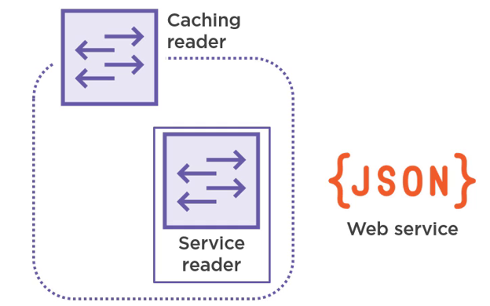
Decorator Pattern
Data Reader Decorator

Slide 44
Code Refactoring
Let’s back to Visual Studio

Slide 45
SOLID – Open/Closed Principle
Existing Data Readers can be Extended without being modified
Software entities (classes, modules, functions, etc.) should be open for extension, but closed for modification.

Slide 46
Request3: UnitTest
The tests are short and easy to understand. This encourages us to use them and write more tests when needed.

Slide 47
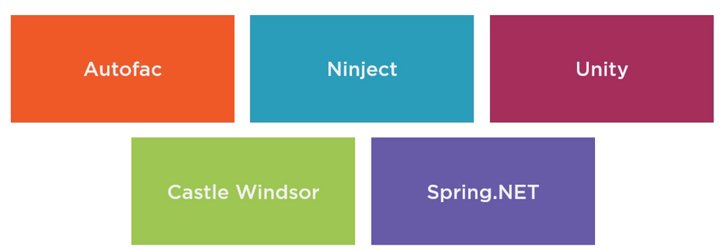
Dependency Injection Containers in .Net

Slide 48
Demonstrate with Ninject
Let’s back to Visual Studio Again

Slide 49
Thank you!

